Slide 1
Civilization infrastructure
Geographic emancipation, ‘Mechanology of unified networks

Slide 2
architecture
Learning the alighnment in all aspects of mans natural adaptation potencial for sucessful connectivity to world information applications platform of life binary tenants and link of where the ‘Alfa tennents of industry holyland dominion standard positions and situations of compliance to tenent enterprise ‘honor of nation complexity to bring people to vision the standings of the creation world creative design architecture, map of cognitive conciousness and vision standards with focused balanced forager of world method and strategic ‘assesments survival competent dependency of binary/orthodox tenent ,focus and concentration are challenged ‘that traditional culture ideology dosn’t imply with the function in binary society to rise to this paradism in evolution/biological is where the life triangulation contributes to the alighnment with the tradition revelation of wisdom and quality’s of balanced intellectual impetus ‘world dual image practices and exercises of life strategic tradjectory methodology, ‘ a lost ethical dimension of world creations ecological life sytems mitigated into the profficient path of life ‘direction and guidance to the essential adaptive human coresponsive sector learning, genomic triangular survival/exsistence father, son, holy spirit {ethos,pathos,logos of expressiveness in the teachings and lineage they represent the productivity as the whole in response to their instrument of stewardship circumstances and positions ect. with the the complexity constant of world reasources of life Hypothesis support

Slide 3
Painting

Slide 4
newcity
They are the world social aphredesiac of man ; fraternity , brotherhood , congregation , and organizational architecture {hierarchy} mechanology of organization; anthropology, cultural principals, life vocations. cononical social mechanology of man enterprise architecture “the imparting cognitive human self sustainance initiative, “implementation aligned with monad architecture for the interchange of thoughts”, opinions, or information by speech, writing, or signs.” It is important to consider that communication is not just verbal in form. communication is more affected by body language, attitude, and tone, in the new testament training orthodox practices condolning the spoken words to carry the crucial content, their meaning can be influenced by the style of delivery, which includes the way future envisioned speakers stand, speak, and look at a person. Enabling However, critical information is often transmitted via handwritten notes,

Slide 5

Introduction to Anthropology concept
A subsistence diochamy reflecting the collective manuscripts from cultural lineages all in one authoritive conclusion to the mystical emancipation of survival. Evolution facts evidence tuteledge, refferences, epic of focus adventis collected through the dissedent family prodigy comprised by holy techniques of life selfsustainance\{culture arts\}.Demographic urban ergronomic methodology's of creations 'human anthropic manuscripts, tuteledge of environment ontology /vertical sucession 'to lifestyle, celestial discipline, anatomic path of life, pedogogi, engineering , stewarsdship and pop 'gospel holy spirit’.

Slide 6

Adventis stewardship entrepreneur
A collectives abstract on a civil movedment from economics of revolution/evolution, the Anthropologists of intuitive cognition, as their ancestors subsistence and productive successes to traditional methods and creation intellectual interactive artifacts of global mapping geographic infrastructure, to align co-ordinates to mapping templates of authentic , organology decended down from the traditions of family survival are the lexical evolution of diversity "tools" mans to connect the logical orthodox methodology to mans \{intellectual\} reasource of life productivity and align the revelations of lexical constants with humam synchronizing authentic binary 'co-ordinated lexical packets/componentry of architectures true guided 'liturgic ontology' 'data information/intel of governing architecture algorithm data of design and collaborate as logically intended throughout the "Anthropology/Ontology ‘infrastructure” collective field of endeavors adaptive translation to the doctoreine of life 'intuitive cognitive consciousness, of five horizons family providence .

Slide 7
Vitruvius /Da Architectura
Arrival of creation vision of ,man determine future from intuitive consciousness ‘to give birth to “Anthropology” domaine of creation man “Newcity”. Vitruvius’ Making.doing,crafting ‘Da Architectura Scope ,scale of architecture. ‘The birth of art’-betterment, best intrests, Architecture of art’. Covenant of man interacts mechanology-life ‘linguistic {essentials-nessesity’s of man. Triangulation of post architecture revelations/theory of design ‘template theory. Anthropic networks ‘creation connection to decorated design of collective creation paradox. Justicce intelligence.

Slide 8

enterprise architecture
A portofolio of social athropology reports: domestic,commercial, industrial demographic society reflecting purpose of life 'creation' diochamy to decypher subsistece costitution of creation 5G covenant precision design schematic applied ergronomic expansion methodologys connect to 'translate the 'hierarchy for life' lexical 'hierarchy for for all primary endeavors,platforms, lexical ordinance of life and affiliates inclusion re-adjustmet from passive tradjectory and dwelve into determined aggressive tradjectory profficientefficient services conservation/preservation 'contributing to environment means impliing on the proper usae of reasources and conflicting demographic 'family scriptures policy and impose compliance to /with mission critical ventures of enterprise as one whole.

Slide 9
Birth of celestial files
EMPIRIC DESTINY OF BUISNESS
Astrological Covenant representing authentic naturalized immunized hieroglyphic path of life. adaptive solarplexus of anatomic ,core ,stock build on fundamental ecological meridians of fundemental growth and developedment, demographic data ‘{balance of all realms}. growth connectivity to the lineages and potencial of organic lifeform best intrest ‘balanced ecology’ creation tradjectory, skilset methodology; skillset advanced ecological all around subsistence initiatives for compassion to resource, harvest ,forage, alignment entitlements for exercises and practices of world brands and trends Old oak tree means of to perform jobs of different levels or task competence demographic statistics of democracyCo-ordinates to ‘newcity’ salvation of man.Celestial {redsky call to action} anthropic biodiversity revelation compliance to ‘empiracle’ tennents ‘of anthropic network in life endeavors of world vocations. Polynomer folklore organic Invention mechanology -compliance formulated growth & developedment methodology’s from research in creation prophecy’s{collective archeives} allocates prodigy of understanding {lineage of balance} in field of life endeavors.Conscious sense Breathe techniques, eye focus orientation co-ordinates of hand productive biomechanic work of man, ‘

Slide 10
files
morphological existence of man’s innovative anatomic efficiency/profficiency of adaptive techniques of major muscle groups from the skillset methodology of ergonomic infrastructure curricular regime, ‘trades and traits of survival/exsistence from hands genomic cononical skillset ‘gift of a foot protection, persona of service, stand in creation biodiversity in culture ettiquette of man, law of world from celestial geneome ordinance of celestial adaptive genomic {collective trajectory} human existential consciousness, pod births philosiphical upbringings, sect topology’s ‘corporate industry’s enterprise carer, compliance to virtual truth enterprise unicorn orientation, ‘simpleness, of ‘geneomic ‘group ‘institution {family,nature} scholar Health plan benefits option of
philosiphic mechanology allocated throughout the sect topology of newcity infrastrucure and 2ndary backup channels to in field of life endeavors.

Slide 11


Subsistence Covenant
Prophecy of forager harvesting
Knowledge wisdom anology

Slide 12
Marketing intuitive consciousness co-ordinates to promisedland /celestrial logos
Financial fundamental-foundations ‘subsistence cellular molten core of ecological subsistence, indegenious revelation of subsistence {capital} skillset /methodoloy {cosmic} social molten core indegenious revelations of creation algorithms,productive ,ecological processes functions harvest capital from life elemental constructs of ‘ground zero’, ‘gravity, radiation from productive ‘occipital’ psuedoscience-apfredesiac, subsistence lifecycle, to interact ‘productive capacity of ‘human’ naturalization to perform work ect.Via,neurol-reflex, muscular skeleton to compile biographic lifesystem subsistence manifest; ‘egronomic infrastructure ‘prophecy of creation liturgic prosperity, ‘innovative tommorrow,’ reflecting on productive bio mechanology,ergronomic infrastructure, agriculture, technology of science ,artifacts {industry} in field of endeavors, ‘strata, fire ,tools, building composite reasources. As in the celestial Diciplines in the field of ‘human life endeavors’, ‘apocalyptic diversity of lifeforms binary inheritance of adaptive methodology{revelations} ; naturalization of creation geneomic statutory equalibrium conciousness re. Millenia Censuses, domaine over world from man’s compliance to ecological stewardship‘covenant ‘enterprise-Architecture’. {Money sequence of value /life sequence of value.}

Slide 13
a.I reality
Soliste zeinith
equinox

Slide 14
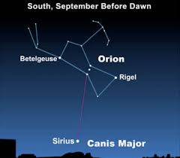

Ergronomic instruments of quram
Cononical proportions stimulus
Vertical horizon statutory

Slide 15
Celestial cosmology
Orionsbelt-Southrncross ,soliste ,equinox chronological ‘planning’ ‘inheritance of earth life endeavors ,collective ‘logos’ revolution for preservation conservation ,concensuses P.T inclusion ,ready state , ‘call to action’. ‘ettiquette creed ‘procedures of community indebted guidance in destiny toward the covenant of the father and son holyspirit ( countenance). Returns the design component authentic subsistence nessesity and ecological, for restoration tradjectory chronological purpose, meaning, cause, ‘alignment of life vocation ‘subsistence.(Alfa-omega). Global universe ‘revolution’ of ‘genesis/ Babylon, “New testament/Nebuchadnezzar’

Slide 16
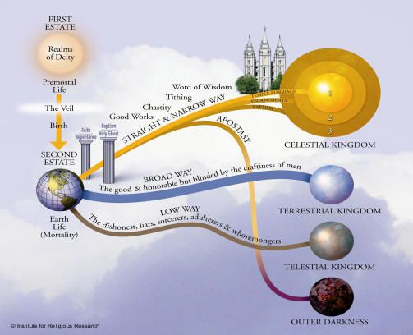
Rituals of the sevenday adventis and cosmological society
They are the world social aphredesiac of man ; fraternity , brotherhood , congregation , and organizational architecture {hierarchy} mechanology of organization; anthropology, cultural principals, life vocations. cononical governance of social mechanology. ‘Man enterprise architecture.
“the imparting cognitive human self sustainance initiative, “implimentation of monad architecture for the interchange of thoughts”, opinions, or information by speech, writing, or signs.” It is important to the componentry of architecture framework , ‘for restored-renewed creation mechanology ‘man’ authentic brand/trend of subsistence; pseudoscience apfredesiac.

Slide 17
Put into context of a Quatum chronological physics actually a partial image of creation philosophical

Slide 18
marketing intuitive conciousness
Agriculture prophecy of environment foundations of transcendental liturgy \par
Civilization theory of construction /man integration "Arknet Engineering" The re-establishment of creation intuitive design, 'construction planning manuscript implimentation 'to guide and align intuitive ecological developedments from community innovation initiatives essentials/nessesity’s .
Reasources of land being the creation mystic subsistence science of mans wisdom in world linguistic knowledge of industry enterprises applications binded to chronological neurturing of the life vocations to enlightened skillset methodology of environmental brands, trades of man and services of the covenant yield of creation productivity/ longivity.
A mechanism to explain /re-interpret the subconcious parrallel relative that evolves with unified creation.

Slide 19
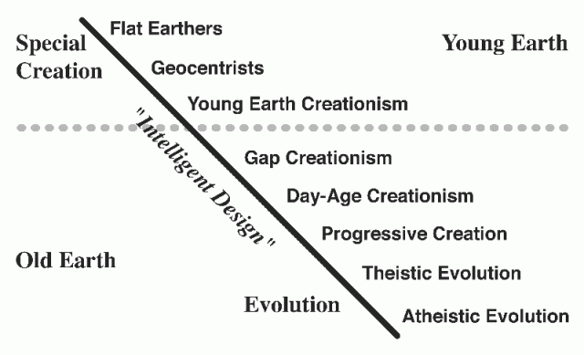

Arknet communications
Collective survival mechanology
New evolution Plannar
Arknet architecture communications

Slide 20
archeology
Demographics ‘prolitariat stewardship of the last decendants ‘to creations collective industry operatives, organizing copywright information of creations exsistence/survival collectiive ideology “world topology”,’ a translation of undisclosed standards’exercises and practices that were mended to yield intuitive virtual-reality of creation to synchronization with engineering variable/factor of earth trajectory to god creation lineage survival protocol

Slide 21
We can implement the complex, multi- dimensional stratedgys of this Enterprise architecture to laminate enterprise r&d, Infrastructure to solve creation, ethics stratedgy, and most proficient alignment of A.I capable global horizon realitys, laminate varification of truths to define explicint commercial occipital horizon industrial, commercial,domestic, and define stratedgic control of the statutory (iso) policys of 5G network satellite horizon to enlightened conveyors of literary creation horizon of lifes legendary, extensive compatible network operatores as are reporter, analyst, journalists, of christian enterprise intel/informations on socialethic (occipital) networks employing virtual reality through statutory unicorn extensive to all endeavor for offering or receptive services of the law in kingdom. Company.

Slide 22
Anthropology concept

Slide 23
empiric stockpile/capital
For reasource of the economic life system of earths life endeavors and social ethic affairs for life divine providence earth air water fire . The geographic antropology relative to the social ethic ideology through work productive performance of human man an essential clergic dicipline of guidance followed through the social life structure of the form to achieve of the antropologic gospel world economics.

Slide 25
Economist
The study and observations of the worlds vocation systems giving explicint sequencial generic information
implicating the probable outcome for circumstanes defined by the hereditary artifacts of life creations life system and environment variables information of life divine-virtues
The economist is an antology of an ethical lifestyle of mans civilized human world economic dependancy these dependancy's reveal of the true ethical denomination of the hereditary human ancestors'impliing on the vocations of ife(civilization) . divine-virtues of creations and of the life conciousness essential/nessesitys endeerment of world creation survival/exsistence.
Genesis of africa ,innnovation of lifestyle ,proffesion, advocate, vocation
Socialcultural ethic of the construct profficient life ideology as the captions chronicles of man ,the revelations of legend of man and profficient social economic prodigy
Genesis of africa ,innnovation of lifestyle ,proffesion, advocate, vocation
Socialcultural ethic of the construct profficient life ideology as the captions chronicles of man ,the revelations of legend of man and profficient social economic prodigy

Slide 26
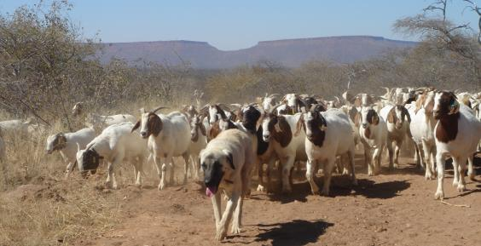
Subsistence man
Since the world is on a direct tradjectory of the fundamental foundation of geographic longtitude the chemistry for methodologic productivity of the occipital poles forces and matter of earth where the generic adaptation with all things intended generic/hereditary methodology for creation lifeform mechanology, censuses-democracy of the entitlement ‘that surpass lifeline geneology doctorine of tradjectory priveledge of the inclusion to rectify the beauty of the creation statutory race and creed. Being fed from the will to survive/exsist through tuteledge to the exposure of the lifes directed purpose means ie. Commodite from construct of systematic occipital jurisprudence ecosystem . For the common good of work, work of the nature, mystic direction and magnitude share role in guidance and direction subsistence articulate of information ‘intelligence’ game’ or ‘emotion folk’ but emotional belonging to the exsistencial understanding of systems interaction of empire and capital at least exhibition of its millenia history manuscript productive developedment .through ecological system compliance. A consciousness of ethical practice and theory.The entitlement and priveledge of skills and trades . To build on this architectural design.

Slide 27
Subsistenceman

Slide 28
Engineering/mechanology
Prolitariat: bergoisie, blue collar, Chase Manhatten. Architectural blueprint rough copy , scratch implied upon variable factors only concieved by man as are interpretation of the creation via architectural scematic of our life creator. Man,world,animal
The new world topology storyboard of creations creative cultural manifest of the creative arts observed and execute in their' sublime social ethic , fundemental principal of world essentials and nessesity as house ,musoleum , palace ; activist writer publisher of industry standard adaptive human code of rights ettiquette to represent fundemental principal developedments relative to of man institutions censuses human reasources
Applicatìn of creations creative arts

Slide 29
Engineering/mechanology
Prolitariat: bergoisie, blue collar, Chase Manhatten. Architectural blueprint rough copy , scratch implied upon variable factors only concieved by man as are interpretation of the creation via architectural scematic of our life creator. Man,world,animal
The new world topology storyboard of creations creative cultural manifest of the creative arts observed and execute in their' sublime social ethic , fundemental principal of world essentials and nessesity as house ,musoleum , palace ; activist writer publisher of industry standard adaptive human code of rights ettiquette to represent fundemental principal developedments relative to of man institutions censuses human reasources
Applicatìn of creations creative arts metaphors; ”Subsistence”

Slide 30
Biographic anthropology of new world Industrialism Commercial, Domestic -Agriculture-Engineering-Economic capitalism-creative arts inventor. Stewardship alighnment for life linguistic destiny ‘the world ontological alighnment ‘the destiny of the world global information systems social media ‘branch anthropology’ the alighnment of civilizations methodology,’the sequencial-generic tool of (anthropological dicipline) report ‘natural life system force for mitigated new world testament of Stewardship and world censuses .

Slide 31

Anthropic co-op/marketing
Plan from ‘harvest of the subsistence covenant, to associate all technology’s ‘of the innovative methodology’s ‘harvested from anthropic orientation of man’s stockpile reasources managedment, and ‘human reasources managedment to prepare probable outcome on conduct, mapping justified paths on relative the provisions needs and essentials to provide on . Vision {jurusalem covenant} ‘goods and servies’
‘goal to innovative diochamy of ’enterprise’proffesional marketing stewardship,invested into harvesting logos covenant intellectual property’s of orthodox creation collective archeive, in all fields of life endeavors.

Slide 32
Proffesional diochamy
Products liturgic hieroglyphs of economic revolution ,War psuedoscience-apfredesiac Old testament, from websites ‘designconstant’ encourages interaction observation to the liturgic messages evolving from the applied sciences of global liturgic ‘dissedence’ as it makes sense of incorporation with the cononical logistics of quantified creation prophecy {5 gospel}in field of Muhammed teachings to apprentis of the empathy of sharing and compassion ‘encourages to adapt the cognitive skills,trades/traits of the ‘body of the whole’ synchronizing the layered atmospheric hierarchy, of generic/inheritance, to conduct the life equilibrium’ to infrastructure answers of the intuitive consciousness, for scholar reaction’ to mathematic leadership of consciousness, natural intuition 'Enterprise apocalypse disciple ‘Covenant Call to action’ archaic censuses,natural equalibrium creation voluntary services ,contribution/mechanology of services ‘adventis lifepath ‘the quram. Enterprise field of life endeavors ‘vocations of life. Abiding life inheritance to compliant social science opportunity’s etiquette honoring life circular ecological sacred geometric inclusion belonging identity ‘career/employment ‘call to action’ covenant of emancipation skills mentor in the the reserve skills stockpile of creation monogamy reaserve competent skills training, of cultural infrastructure, the atmospheric guidance tradjectory of process development growth/vertical horizon bio mechanical anthopological purposes manuscript to liturgical environment governance of interaction with all things in the life endeavors of creation to find sacred liturgy of life ‘the mechanology of creations geological architecture poses ethical methodology reflecting on the ballistic/forensic character profile of biology in all life forms. A reflecting constitution of the anatomic i.p statutory sources and resources varying growth trajectory characteristics input-output ideology cause-effect .

Slide 33
Proffesional diochamy

Slide 34
Diochamy of designconstant
Architecture technology created through analysis and observation to a possible conclusion of lifes paradox’ of world cononical tradjectory from as far back in history to new innovative breakthroughs of creation vision of probability, all reflecting man’s order/orientation over all dominion and domaine of creation enterprise architecture.
Design created through the pseudoscience apfredesiac to locate and understand the future in verified orientation for the manuscripts in diochamy of options

Slide 35
Elder scholar dissidence of wisdoms evolving through the creation channels of covenant Alfa beta gamma delta humanbeing and collective life decendance of man world God . Information allocated from the mortal armeggedon of human leadership/ collaboration, for man as species or supreme humanbeing in footsteps of best interest in mans self sustainance of subsistence survival “diochamy” as in the bible. Where the protocol of real things define the true mechanology of living and mastery to record and send to mankind the likeminded logical ‘innovative capability Provisions from sources/ and reasources of world holy instruction/dissidence which could have aquired probable cause of intellectual meaning diochamy of creations binary productive ( radioactive architecture of cononical creation.

Slide 36
Co-ordinates and orientation for human collective translation of ‘guided’ theosiphic initiative. horizontal-covenant ‘manifestations of the earth unveiling to perfection in it’s vision of millenia. Information/intel for horizontal statutory, productive practices-exercises of evolution prophetic monad conditioning,alliance of preservation courage to endure ‘diversity’s variable elite illicint ‘occipital’ compliance to {fermone} natural intuitive “lifepath” gravity-atmosphere-productivity ‘authentically a diochamy of collective horizon channel pseudoscience-apfredesiac, ‘road to glory’ man’s domaine over all life-lifeform performed in great humility to respond to call of creation inclusion . Inspiration of psycological warfare.

Slide 37
A deducted Global circular world, ‘by the Liturgic manuscripts ‘‘occipital’ Unified order ‘of all livingthings’, ‘Brotherhood of man’ collective tradition of human equilibrium, Uniting world dissidence of ‘life unified call to action, ‘employs social ethic structural linguistic parables harnessed from ‘occipital’ methodical forces of life vocations labour of love contribution of diversity, wisdom /impetus tradjectory collective ”new millena” Individual exsistencial creation natural intuitive ‘conciousnes i.q-.eq relative-parrallel creation ‘cognitive’ statutory composite creation quantification, from inspired mechanology of formulated ‘multi dimensional’ collective subsitence base antiquity’s of values,,property’s,quality’s ergronomic mechanology.

Slide 38
Designconstant
Design constant ‘enterprise services’

Slide 39
Anth hier
Security defined by intitive consciousness of cognitive ‘anthropological constant, integration of life ergronomic via implementation of analysis observation, of life diversity experience ,engineering via ‘ergonomic tuteledge construct for infrastructure statutory standards ethos,pathos,logos

Slide 40
To ‘varify’ binary understading of creation subsistence universe in the virtual understanding of the life endeavors “money sequence of value” and life reproduction ‘life sequence of ‘value” an economic obstruction of compasson /benovalence, ‘methodologic survival practices primary translation of consciousness and concentration define over philosophic mathematic algebraic harmony nostalgic novelty of mathematic translation formula all material things /commodite.
Carer vocation caregiver democratic/orthodox social public services economy
The invisible Hand ‘black market folklore Preprint/registration
Legal economic entity john lock property provision left over non spoil product for co-operative efficiency ‘democratic’ canonical understandings in field of ‘life endeavors’ ‘as the vehicle in financial systems ‘common wealth’ as opposed to individual ,private aboundances policy’s of wealth.
private property introduction of money race,sions, capital assets vs humility of finance in antiquity of social governance treaties. Private property became product property earned by labour translated into the capital assets, investments ‘of load institutions’ from sacrifice ‘as due process from persistent civil diochamy
Challenge ‘to impliment, restoration ‘enterprise unicorn’
Leadership of enterprise Investors of egronomic labour challenges compiled last guiding light given and equilibrium of supply and demand concise through non elementary organology world productive initiative.
Trending close stock
Consumption ideology preservation efficiency consumption of demographic subsistence ideology
Real value ,quality of lives and lifestyle
To ‘varify’ binary understading of creation subsistence universe in the virtual understanding of the life endeavors “money sequence of value” and life reproduction ‘life sequence of ‘value” an economic obstruction of compasson /benovalence, ‘methodologic survival practices primary translation of consciousness and concentration define over philosophic mathematic algebraic harmony nostalgic novelty of mathematic translation formula all material things /commodite.
Carer vocation caregiver democratic/orthodox social public services economy
The invisible Hand ‘black market folklore Preprint/registration
Legal economic entity john lock property provision left over non spoil product for co-operative efficiency ‘democratic’ canonical understandings in field of ‘life endeavors’ ‘as the vehicle in financial systems ‘common wealth’ as opposed to individual ,private aboundances policy’s of wealth.
private property introduction of money race,sions, capital assets vs humility of finance in antiquity of social governance treaties. Private property became product property earned by labour translated into the capital assets, investments ‘of load institutions’ from sacrifice ‘as due process from persistent civil diochamy
Challenge ‘to impliment, restoration ‘enterprise unicorn’
Leadership of enterprise Investors of egronomic labour challenges compiled last guiding light given and equilibrium of supply and demand concise through non elementary organology world productive initiative.
Trending close stock
Consumption ideology preservation efficiency consumption of demographic subsistence ideology
Real value ,quality of lives and lifestyle

Slide 41
Diochamy ‘the emancipation of ontology’s
An apocalypse, will the democracy rise to complete fulfill of the goals, for the requiem of censuses statistics to evolve into new ‘creation diochamy’ policy for ‘collective enterprise’ technology update architecture ‘diochamy’ From revelations ‘Emancipations of the human/geographic Ontology ‘ are aligned a a combination of creative arts construction initiatives which are the instruments of our initiative to align identify and measure antiquity values quotient of quality’s our remainding collective integration from antiquity’s of folklore rituals and pratices in the form of industry skillset methods and practices which employ the balanced forces millenia ‘blockchain’ initiatives from single source community ‘s can connect to potencially capable selfsustainance ‘sector of corporate topology ’ which generated all natural goals of emmissions ‘prodigy of the horizon and interactive life integration from accountable creation conciousness. ‘anthropology connect community’ of high stakes production tradjectory calculated data sacrifice .

Slide 42
Job start
connected to world instrumentation design, state of Architectural engineering instrumentation template of the domesticated linguistic subsistence rituals of subsistence anthropology that trend of family 'call to action' to honor the penninsula of endeavor to success, diversity, knowledge, wisdom endeavors ergronomic survival, mechanology use of {data} that decrypted liturgic unveiling innovative transcendental methodical to mathematical alignment to direct patterns of life system reasource and 5 g antiquity of demographic capable visions {ritual} purpose meaning cause manuscripts .. to bring authentic creation chroicles to guiding light for creation innovations technology trend/brands- implimenting technology from discovery of it's noble cause and effect on creative innovation platform from monad to networks 'Quram' product market arriving as gift from life newly created, evolving on the engineering of diversity innovations and technology to share to the industry and market of enterprise architecture sucess of data information/intel domestic,commercial, industrial stock trade pop demonstration of profficiency ordinance {transcendental mathematics} ect.

Slide 43
A subsistence diochamy reflecting the collective manuscripts from cultural lineages all in one authoritive conclusion to the mystical emancipation of survival. Evolution facts evidence tuteledge, refferences, epic of focus adventis collected through the dissedent family prodigy comprised by holy techniques of life selfsustainance\{culture arts\}.Demographic urban ergronomic methodology's of creations 'human anthropic manuscripts, tuteledge of environment ontology /vertical sucession 'to lifestyle celestial discipline, ‘anatomic path of life pedogogi, engineering stewarsdship and pop 'gospel holy spirit denomination’.

Slide 45
Orionsbelt-Southrncross ,soliste ,equinox chronological ‘planning’ ‘inheritance of earth life endeavors adventis ,collective ‘logos’ revolution for preservation conservation ,concensuses P.T inclusion ,ready state , ‘call to action’. ‘ettiquette creed ‘procedures of community indebted guidance in destiny toward the covenant of the father and son holyspirit ( countenance). Returns the design component authentic subsistence Infrastructure, nessesity and ecological, for restoration tradjectory chronological purpose, meaning, cause, ‘alignment of life vocation ‘subsistence.(Alfa-omega). Global universe ‘revolution’ of ‘genesis/ Babylon, “New testament/Nebuchadnezzar’

Slide 46
As the earth orbits the sun over the year, the sun appears to move on the celestial sphere against the background of the fixed stars. (Another illusion: it's the earth and the observer moving around the sun as data steward to sundial ‘collecting artifacts of sun, ‘ergronomic, cosmic anthropological ‘socialethic, rather than the sun changing its position.) The curving path the sun seems to follow is called the ecliptic, which passes through a series of twelve constellations called the Zodiac. Efficiency-proficiency ‘conservation-preservation. Short of the ‘authentic creation’ political governance stratedgic intuitive consciousness stratedgy of nature, litugic ,emotional, intellectual, apostolic 12 diciples. Chronicles ,politics to control ‘365 diochamy of man, apostle paul held back essential freedom constitution that were conceived in order to mortally perform enterprise diochamy of king by will to believers and prosperity of infinite and eternal life, ‘to all bearing life unto his majesty law of civilization ethics.

Slide 47
As the earth orbits the sun over the year, the sun appears to move on the celestial sphere against the background of the fixed stars. (Another illusion: it's the earth and the observer moving around the sun as data steward to sundial ‘collecting artifacts, ‘ergronomic, cosmic anthropological ‘socialethic, rather than the sun changing its position.) The curving path the sun seems to follow is called the ecliptic, which passes through a series of twelve constellations called the Zodiac. Efficiency-proficiency ‘conservation-preservation. Short of the ‘authentic creation’ political governance stratedgic intuitive consciousness stratedgy of nature, litugic ,emotional, intellectual, enterprise Chronicles ,politics to control ‘365 diochamy of man, apostle paul held back essential freedom constitution {Quram} that were conceived in order to mortally perform enterprise diochamy of king by will to believers and prosperity of infinite and eternal life, ‘to all bearing life unto his majesty law of civilization ethics.
Of reasource intellectual mechanology

Slide 48
Professionals' personelle of highstakes output , acheiving scorers on the grid intuitive expansion of social media and capital. A centralization of everything going on. Geography, Ontology, Anthropology and the mentor/dicipleship inheritance of transcendental-exsistencial-vocational wisdom; are the foundation of creative forces established by man "his own world." from the willing congregation of society innovation directed and guided by the compliances policy's democratic. Than we know Proffesionals adapting to covert trusted groups to try to get the information on elite infrastructure to carer/professional personelle 'diochamy of co-ordinate' where we can evaluate the reasources of crisis regulation for the enterprise ergronomics mechanology of machinery , proceedures protocol to enterprise forces proceedural regulations to justify intuitive enterprise contractual compliance with 'enterprise logistic ;'economic 'democratic methodology, 5G covenant evolution Anthropological concept' enterprise 'law of nature design 'horizontal foundation for vertical fututre Architecture ideology .

Slide 49
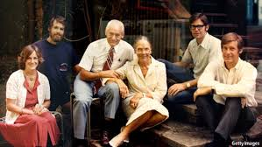
Anthropologic hierarchy
From intuitive consciousness interacts the pathways world man animal as the three celestial kingdoms, straight and narrow as Christian ‘trial and error’. To define man of the atmospheric environmental foundation of creation instrument and precision to the ‘logos’ media of guidance .
Intellectual property extracted from structured statutory ‘occipital’ infrastructure antiquity’s of intellectual ideology ,arranged via ballistic/forensic variable life pattern, aspects, life vocation of life endeavors
Updated subsistence portfolio as were prescribed ‘creation, ‘occipital’ binary science infrastructure of nature. “seed of Christ”. Is brought back into the limelight of creation social policy, to defeat ,combat epidemic bound disallusion of world safety and security.

Slide 50
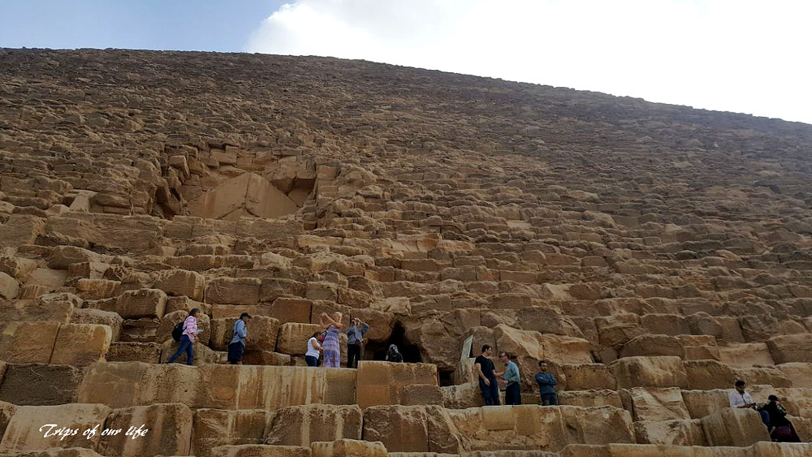
subsistence monuments reflecting dedicated subsistence ordinance
Magnitudinal state ‘instrument of the static binary universe to introduce unicorn to the life vocations.

Slide 51
structuraltransformation
Clip pad

Slide 52
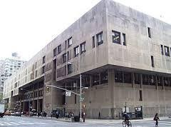
Curam
Part 3
Testing : Anthropologic phoneomic Alphabet, Stratedgy, tactics / Censuses, humanitys essentials nessesitys , Economics -infrastructure , anthropic networks - intel information,

Slide 53
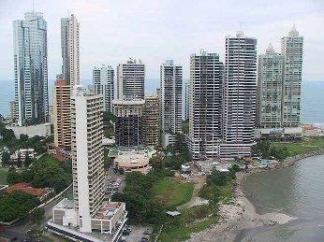
Curam
Transition of graphic world dual image architectural desighn reflects upon the afredesiac of creation innovative prodigy, algorythm of statutory constants and social ethic anthropology. Afredesiac platform for identification of the human mechanology implimentation schematic for world fundemental logic of life ‘tuteledge’ inspiration principal of nurishment, intuition of ethical provisions intellectual-property, natural ,pure ,and holy world adaptive belonging-identity of the soul to life source, trust and honor to life salvation of earths enlightenedment ' survival and exsistence, 'diversity, exercises-practices co-ordinated collective archeive of natural inherited and man made innovative compliance of world technology ,'Data/ censuses , factors , ’ecological /variables catastrophic , enable the data factor for exsistence to geographical world standards 'manifest world orientation of life flourishment fullfillment intersecting the hirogliphic genes to the world stewardship and life vocations social ethic methodological principal of unified desighn world structure to follow latest dominion of the practice/ vocation social cultural benifit of human ideology to be in compliance with earths mystic tradition of the calendar chronicles and manifest metabolic hunting ,fishing , agriculture ,domestic culinary trades/traits all intellectual property of the generically and hereditary world inheritance probable constants, revise lifepath ideology patent ‘monad package to reconaiasance with landing on unified generic lineage with afredesiac of biological world creation.

Slide 54
Quram
Reasources of dual image {five gospels} world prodigy generates the life standards of sequencial world implimentation parables in innovative guidance of the destiny /dynasty of hirogliphic intelligence -pedogogi-avatar-socialethics-stewardship-vocations of life-testament via gods will. 'manifestation of anthropology-intuitive conciousness to stewardhip of life vocation. inexplicint guidance and direction of world prodigy.
All ideology of life is subject to : environment-erogronomics- infrastructure-social culture. 'what is inevitably perfect and precision is the gospel sequencial generic matrix interface of world creations 'innovative ecological information and intel of mechanology and man .

Slide 55
dicipline
Transition of, graphic world dual image architectural desighn reflects upon the afredesiac of creation innovative prodigy, algorithm of statutory constants and social ethic anthropology. Afredesiac platform for identification of the human mechanology implimentation schematic for world fundemental logic of life ‘tuteledge’ inspiration principal of primary intuitive,natural intuition of ethical provisions, intellectual-property, natural ,pure ,and holy world adaptive belonging-identity of the soul to life source, trust and honor to life salvation of earths enlightenedment ' survival and exsistence, 'diversity, exercises-practices co-ordinated collective archeive of natural inherited and man made innovative compliance of world technology ,'Data/ censuses , factors ecological /variables catastrophic , enable the data factor for exsistence to geographical world standards 'manifest world orientation of life flourishment fullfillment intersecting the hirogliphic genes to the world stewardship and life vocations social ethic methodological principal of unified desighn world structure to follow latest dominion of the practice/ vocation social cultural benifit of human ideology to be in compliance with earths mystic tradition of the calendar manifest metabolic hunting ,fishing , agriculture ,domestic culinary trades/traits all intellectual property of the generically and hereditary world inheritance probable constance lifepath ideology patent unified generic line with afredesiac of biological world creation.

Slide 56
Stewardship engineering reference to proffesional {iso} systems of orientation in enterprise career tradjectory ‘Mentor of Vision; analytic creation tradjectory {demographic censuses} (Irs) reports technological carer mentorship security as ‘intuitive consciousness’ cerebral clarity of ‘enterprise trusted networks ‘institutional enterprise logistics. ‘Occipital/Celestial’, diochamy of man Anthropology, ‘ censuses/Urban creation united humility of education ‘empathy as federal/democratic enterprise algorithm generates “NewCity” jurisprudence.

Slide 57
Horizontal channel ontology emancipation
The translation for the landing co-ordinates of both the horizontal and vertical guidance to merge, and unite into one mechanology of life system variance of {lexical,artifact/translation}engineering design construct stage logistic prototype of ecliptic force matter environment in impetus of world chronicles ‘chronological constant of the binary/clerical network orthodox logistic-innovative tommorrow.

Slide 58
Creation consciousness /countanace
The noble benovalence pursuit from impetus initiatives of the Greko-Roman Christian family, ‘inspiration from calculated and measured aspects democracy method to verify correctness of ethical civilization standards align near to Christian standards. In the field of endeavor methodology ‘ linguistic of ‘multi dimensional awareness’ of vertical productivity standards, ‘valued personal acheivedments covenant of all lifeform endeavor statutory purpose,charisma in binary ‘commitment,dedication,will to serve honor ‘graphics’ based sacred guidance .

Slide 59
A subsistence diochamy reflecting the collective manuscripts from cultural lineages all in one authoritive conclusion to the mystical emancipation of survival. Evolution facts evidence tuteledge, refferences, epic of focus adventis collected through the dissedent family prodigy comprised by holy techniques of life selfsustainance\{culture arts\}.Demographic urban ergronomic methodology's of creations 'human anthropic manuscripts, ‘tuteledge of environment ontology /vertical sucession 'to lifestyle celestial dicipline anatomic path of lfe pedogog engineering stewarsdship and pop 'gospel holy spirit’ .

Slide 60
Products liturgic hieroglyphs of economic revolution ,War psuedoscience-apfredesiac Old testament, from websites ‘designconstant’ encourages interaction observation to the liturgic messages evolving from the applied sciences of global liturgic ‘dissedence’ as it makes sense of incorporation with the cononical logistics of quantified creation prophecy {5 gospel}in field of
Muhammed teachings to apprentis of the empathy of sharing and compassion ‘encourages to adapt the cognitive skills,trades/traits of the body of the whole synchronizing the layered atmospheric hierarchy of generic/inheritance to conduct the life equilibrium to infrastructure answers of the intuitive consciousness for scholar reaction mathematic leadership of consciousness natural intuition Enterprise apocalypse disciple ‘Covenant Call to action’ archaic censuses,natural equalibrium creation voluntary services ,contribution/mechanology of services ‘adventis ‘the quram. Enterprise field of life endeavors ‘vocations of life. Abiding life inheritance to compliant social science opportunity’s etiquette honoring life circular ecological sacred geometric inclusion belonging identity ‘career/employment ‘call to action’ covenant of emancipation skills mentor in the the reserve skills stockpile of creation monogamy reaserve competent skills training, of cultural infrastructure, the atmospheric guidance tradjectory of process development growth/vertical horizon bio mechanical anthopological purposes manuscript to liturgical environment governance of interaction with all things in the life endeavors of creation to find sacred liturgy of life ‘the mechanology of creations geological architecture poses ethical methodology reflecting on the ballistic/forensic character profile of biology in all life forms. A reflecting constitution of the anatomic i.p statutory sources and resources varying growth trajectory characteristics input-output ideology cause-effect .

Slide 61
Celestial media/prophecy
of life architecture, methodical permissions and exercises as reasources to organize or create , build on the futuristic principals of monad or conception of Quram media. if not local and orthodox subsistence structure {infrastructure} ones{pisti} eminating intelligence energy and forces of life power from the geneologic order of creations ecological binary architecture and synchronize the inheritance of the world unified collective scriptures Anthropology concept information /intel establishes chronological connection with unified architectural methodology to structures of organism of binary world fundamental foundation on rituals defined from the collective manuscript of unified linguistic on social ethic diversity in whole and complete’

Slide 62
Celestial human
And now remember, my son, that God has entrusted you with these things, which are sacred, which he has kept sacred, and also which he will keep and preserve for a wise purpose in him, that he may show forth his power unto future generations.

